Slide 1
Unit-II Linked List
Definition: A Linked List is a collection of data elements called nodes in which linear representation is given by links from one node to another node

Slide 2
Advantages of Array
No need to declare large number of variables individually.
Variables are not scattered in memory , they are stored in contiguous memory.
Ease the handling of large no of variables of same datatype.

Slide 3
LIMITATION
Can be hard to add/remove elements.
Cannot be dynamically resized in most languages.
Memory loss.

Slide 4
Array have following 2 major drawbacks
Contiguous memory allotment
Size of the array

Slide 8
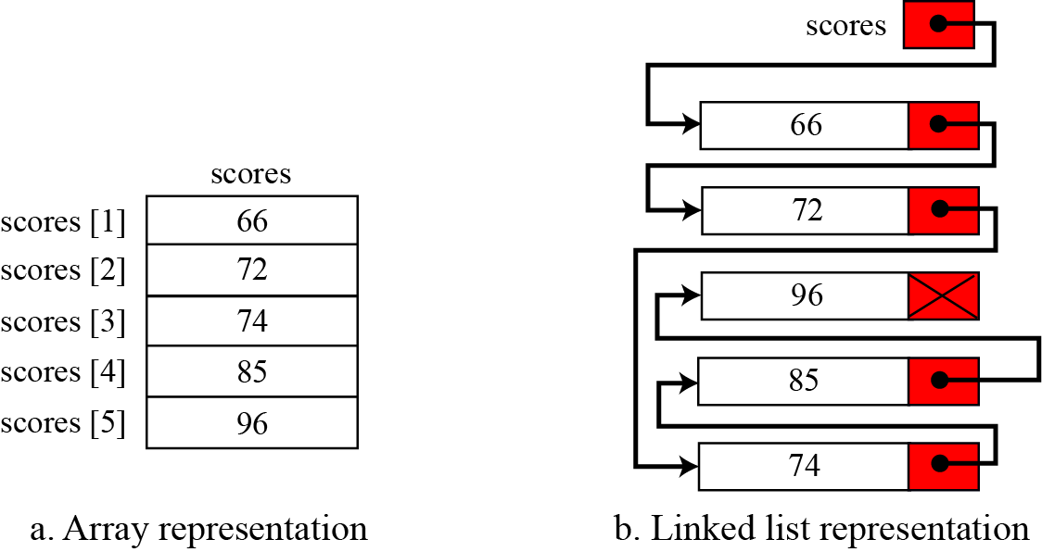
Arrays versus linked lists
Both an array and a linked list are representations of a list of items in memory. The only difference is the way in which the items are linked together. Figure 11.11 compares the two representations for a list of five integers.
Figure 11.11 Array versus linked list
11.4

Slide 9
Singly Linked Lists and Arrays
Singly linked list Array
Elements are stored in linear order, accessible with links.
Elements are stored in linear order, accessible with an index.
Do not have a fixed size.
Have a fixed size.
Cannot access the previous element directly.
Can access the previous element easily.
No binary search.
Binary search.

Slide 10
Advantages of linked lists
Linked lists are dynamic, they can grow or shrink as necessary
Linked lists are non-contiguous; the logical sequence of items in the structure is decoupled from any physical ordering in memory.
CS314
Linked Lists
6

Slide 11
Applications of linked lists
A linked list is a very efficient data structure for sorted list that will go through many insertions and deletions.
A linked list is a dynamic data structure in which the list can start with no nodes and then grow as new nodes are needed. A node can be easily deleted without moving other nodes, as would be the case with an array.
For example, a linked list could be used to hold the records of students in a school. Each quarter or semester, new students enroll in the school and some students leave or graduate.

Slide 12
LINKED LISTS
A linked list is a collection of data in which each element contains the location of the next element—that is, each element contains two parts: data and link. The name of the list is the same as the name of this pointer variable. Figure 11.9 shows a linked list called scores that contains four elements. We define an empty linked list to be only a null pointer: Figure 11.9 also shows an example of an empty linked list.
11.8

Slide 13
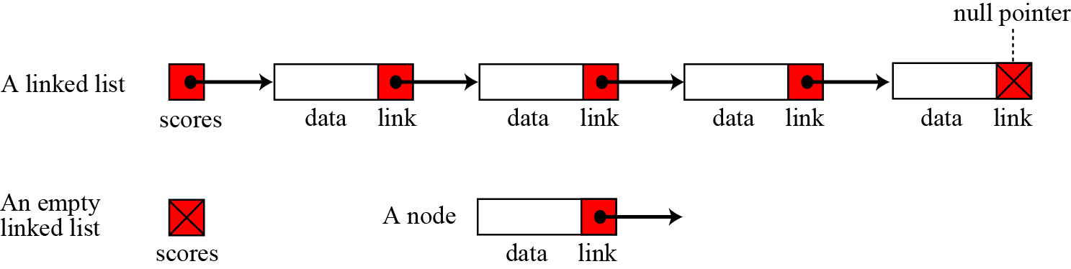
Figure 11.9 Linked lists
11.9

Slide 15
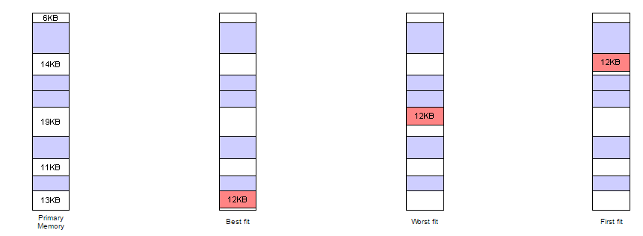
Memory Allocation Strategies

Slide 22
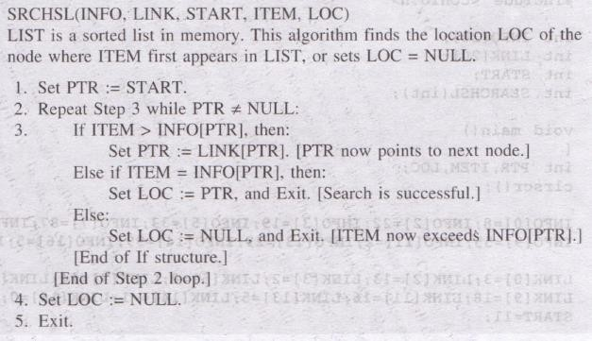
Searching(When the list is sorted)

Slide 30
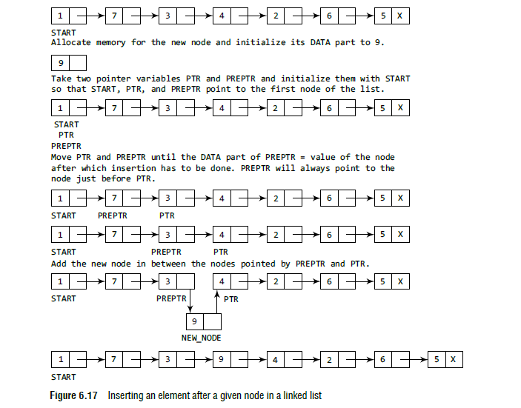

Slide 31
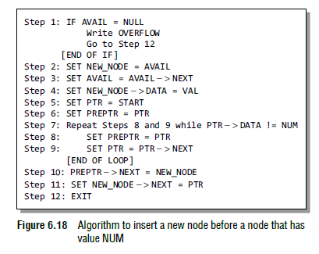

Slide 32
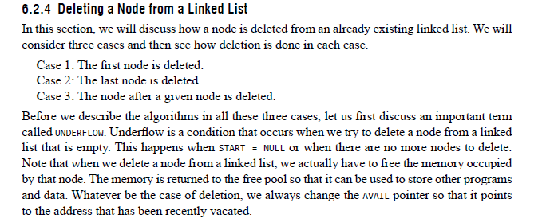

Slide 33
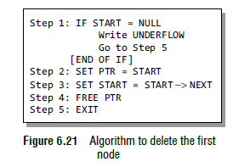
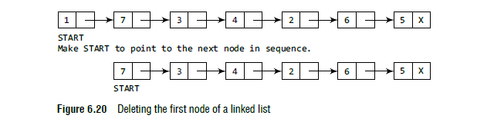

Slide 34
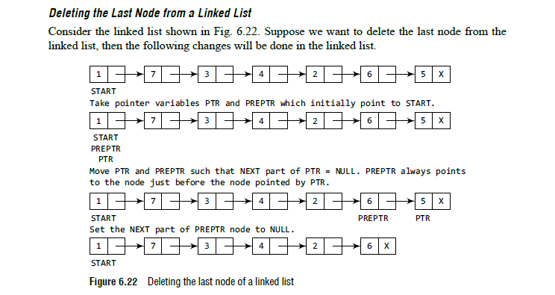

Slide 35
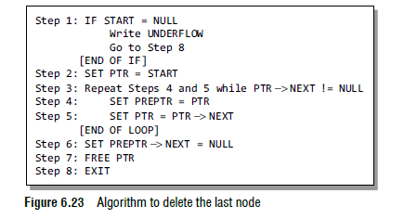

Slide 36
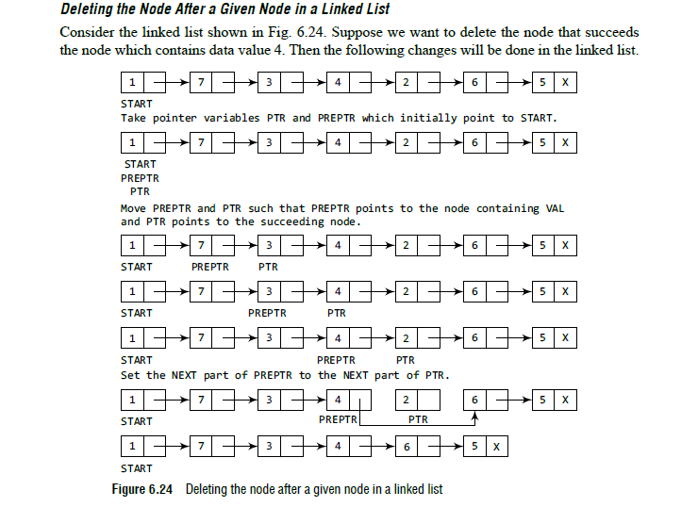

Slide 37
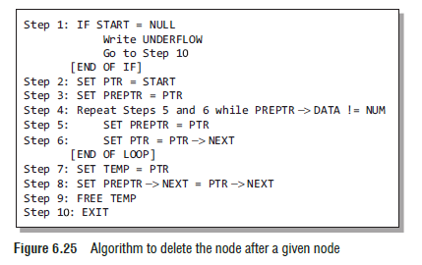

Slide 38
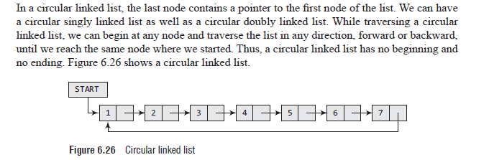
CIRCULAR LINKED LISTs

Slide 39
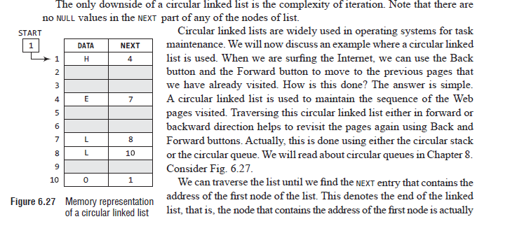
the last node of the list. When we traverse the DATA and NEXT in this manner, we will finally see that the linked list in Fig. 6.27 stores characters that when put together form the word HELLO.

Slide 40
Inserting a New Node in a Circular Linked List
How a new node is added into an already existing linked list. We will take two cases and then see how insertion is done in each case.
Case 1: The new node is inserted at the beginning of the circular linked list.
Case 2: The new node is inserted at the end of the circular linked list.

Slide 41
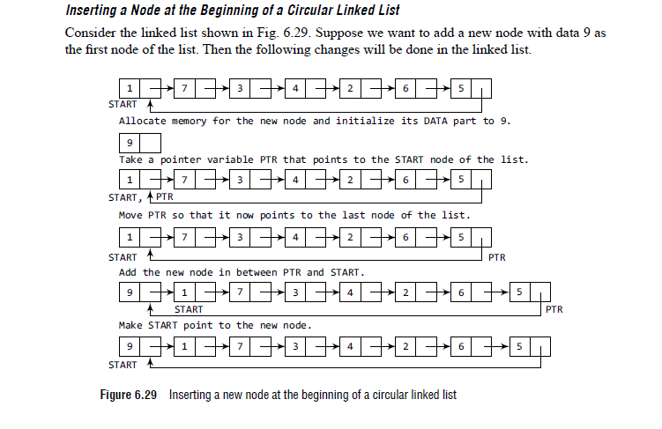

Slide 42
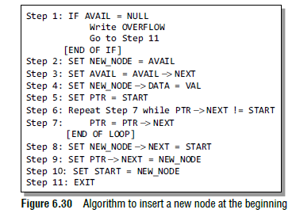
Algorithm to insert a new node at the beginning

Slide 43
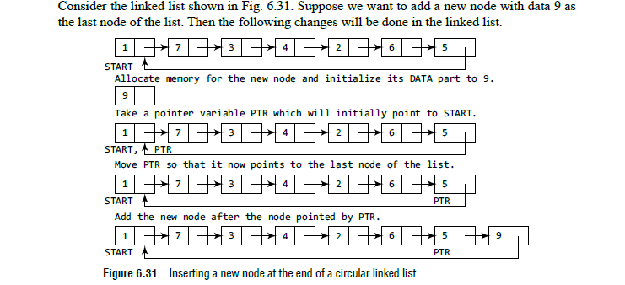
Inserting a Node at the End of a Circular Linked List

Slide 44
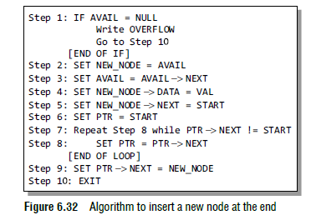
Insert a new node at the end

Slide 45
Deleting a Node from a Circular Linked List
How a node is deleted from an already existing circular linked list. We will take two cases and then see how deletion is done in each case. Rest of the deletion are same as that given for singly linked lists.
Case 1: The first node is deleted.
Case 2: The last node is deleted. cases of

Slide 46
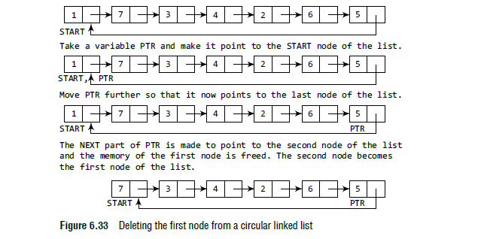
Deleting the first node from a circular linked list

Slide 47
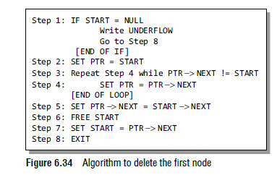

Slide 48
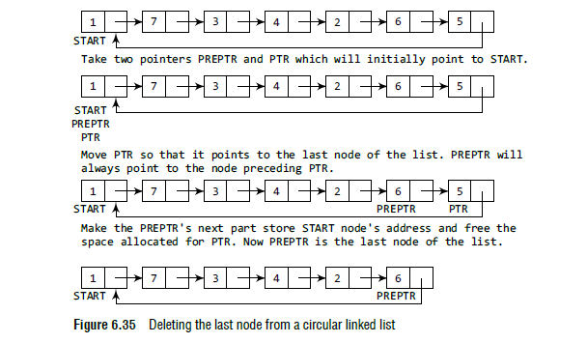
Deleting the Last Node from a Circular Linked List

Slide 49
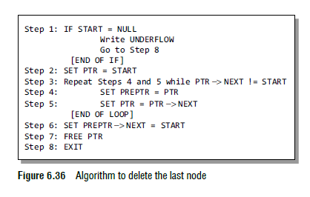

Slide 50
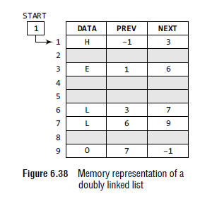
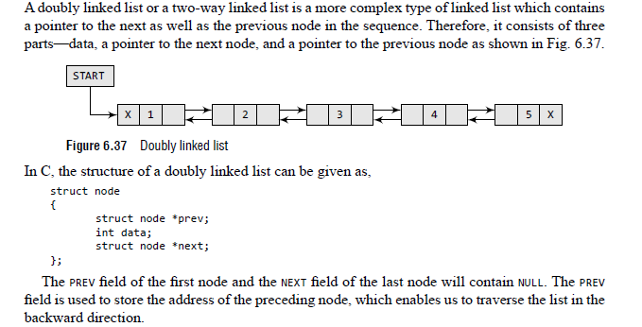
DOUBLY LINKED LISTS

Slide 51
Inserting a New Node in a Doubly Linked List
How a new node is added into an already existing doubly linked list. We will take four cases and then see how insertion is done in each case.
Case 1: The new node is inserted at the beginning.
Case 2: The new node is inserted at the end.
Case 3: The new node is inserted after a given node.
Case 4: The new node is inserted before a given node.

Slide 52
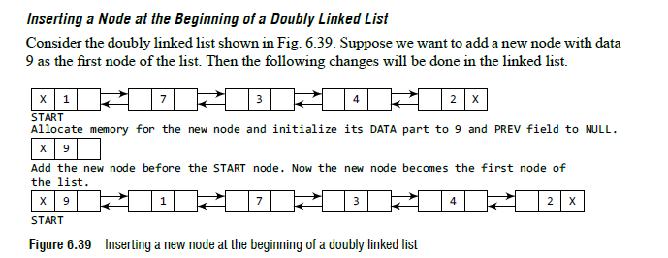
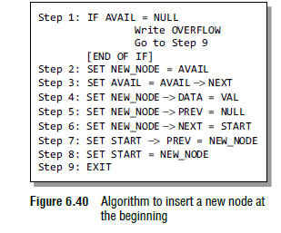

Slide 66
Two Polynomials Addition, Subtraction is a very good example of:
Copy one Linked List to another Linked List
Concatenate few terms(nodes) of one linked list to the end of the another linked list.
e.g. Polynomial 1→ 10 X^4 + 8 X^3 + 6 X^1 = 0
Polynomial 2→ 7 X^4 + 9 X^2 + 8 X^1 + 15 X^0 = 0
---------------------------------------------------------------------------------------
Polynomial 3→ 17 X^4 + 8 X^3 + 9 X^2 + 14 X^1 + 15 X^0 = 0
How the polynomial addition works covers the topic of Copy and Concatenate operation w.r.t. linked lists.

Slide 67
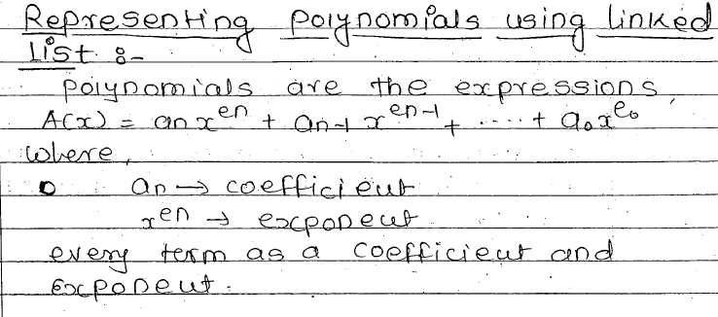

Slide 68
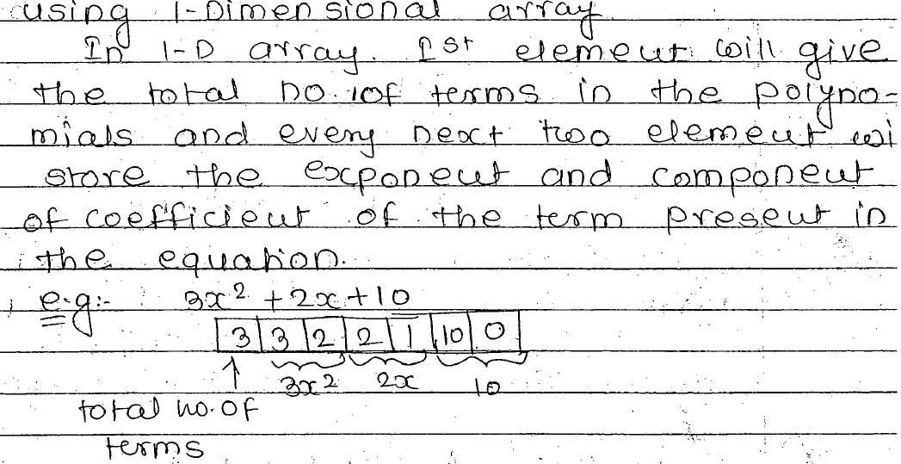

Slide 69
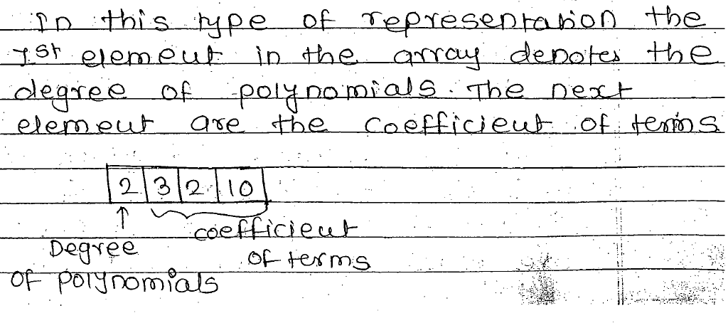

Slide 70
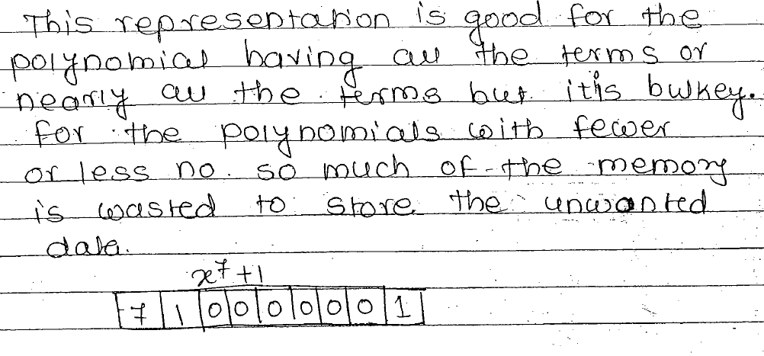

Slide 71
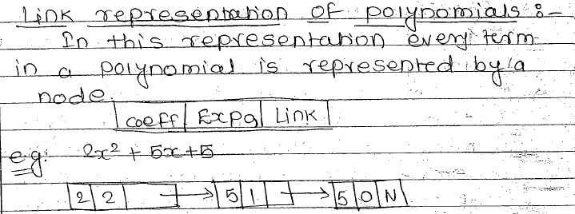

Slide 72
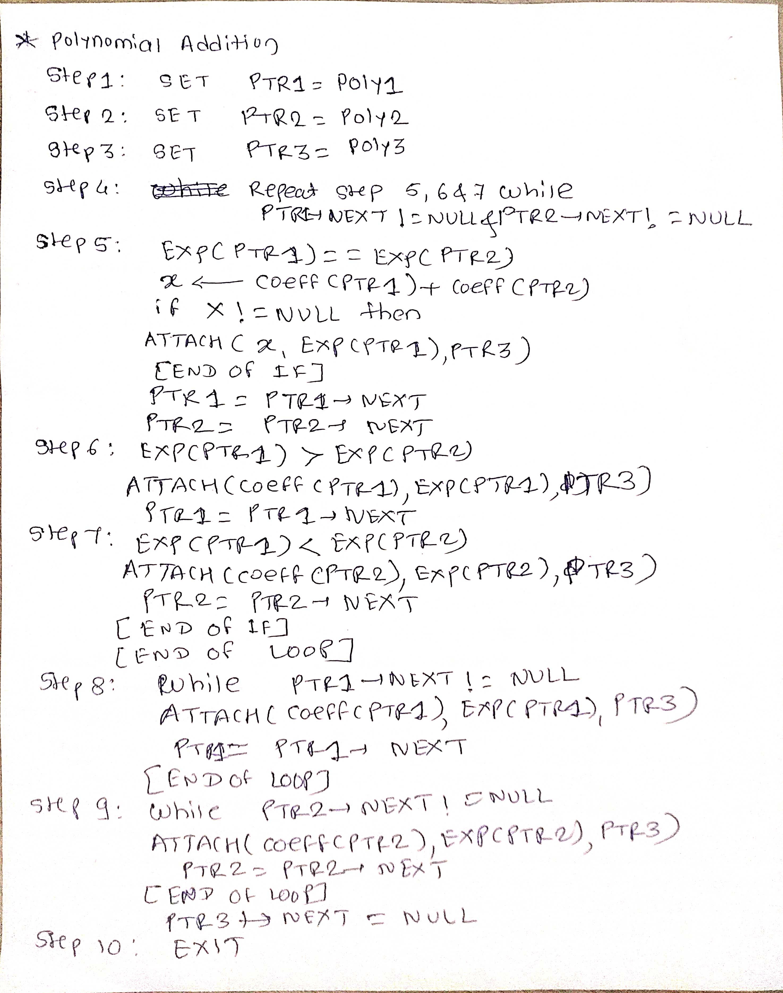

Slide 73
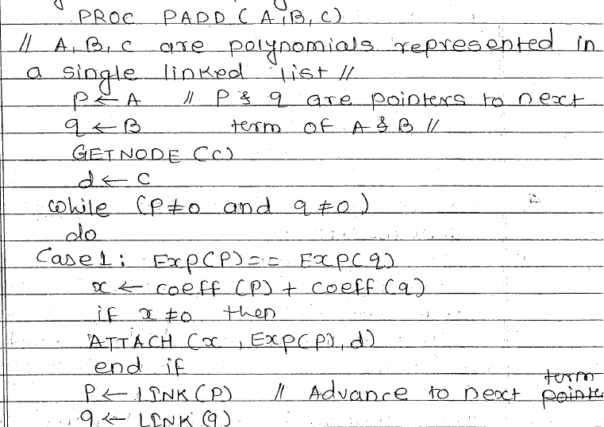
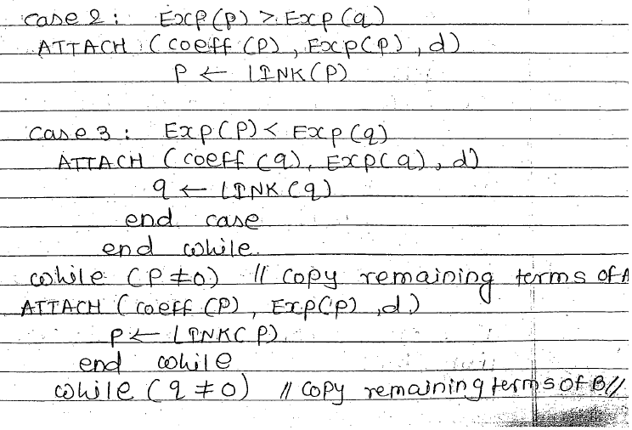
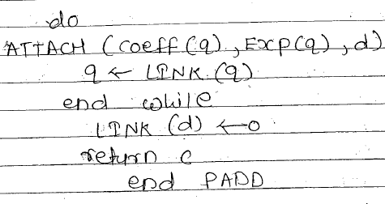

Slide 74
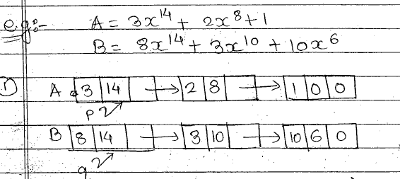

Slide 75
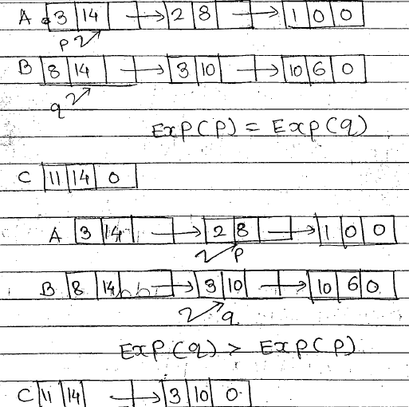

Slide 76
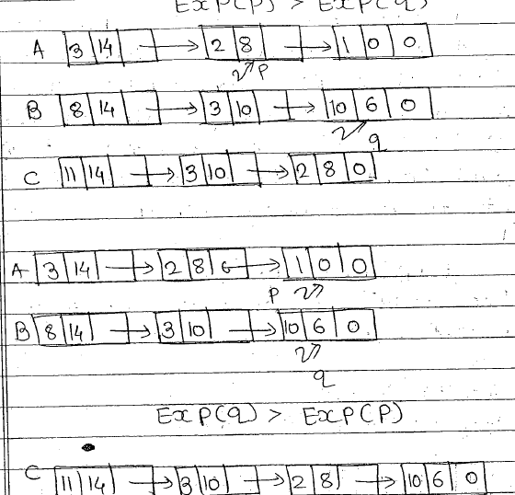

Slide 77
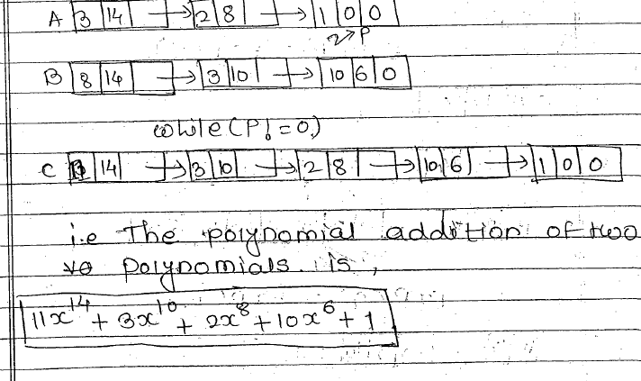

Slide 78
Subtraction of Polynomials using Linked list Theory
In the polynomial linked list, the coefficients and exponents of the polynomial are defined as the data node of the list.
For subtracting two polynomials that are stored as a linked list. We need to subtract the coefficients of variables with the same power.
In a linked list node contains 3 members, coefficient value link to the next node.

Slide 79
Two Polynomials Subtraction:
e.g. Polynomial 1→ 10 X^4 + 8 X^3 + 6 X^1 = 0
Polynomial 2→ 7 X^4 + 9 X^2 + 8 X^1 + 15 X^0 = 0
---------------------------------------------------------------------------------------
Polynomial 3→ 3 X^4 + 8 X^3 - 9 X^2 - 2 X^1 - 15 X^0 = 0

